Slide 1


Modeling Olfactory For Virtual Reality System
Dawson McClary, Chris McReynolds, Candice Reyes
Capstone Project for ELM-5523-999
July 27, 2025

Slide 2


Introduction
Virtual Reality (VR) therapy shows promise for treating PTSD
Current VR lacks olfactory (smell) feedback
Smell is critical for emotional processing and trauma recall
Project Purpose: Integrate scent into VR therapy
Project Objectives
Develop a machine learning model for scent classification​
Design a wearable scent-emitting device for VR use​
Align development with system engineering principles​
Address ethical, clinical, and technical constraints

Slide 3

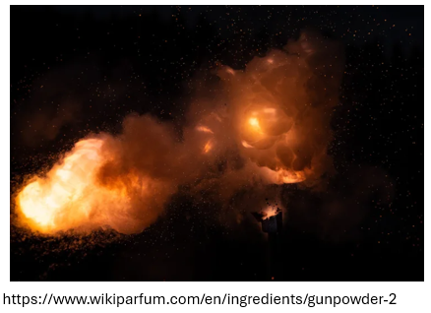
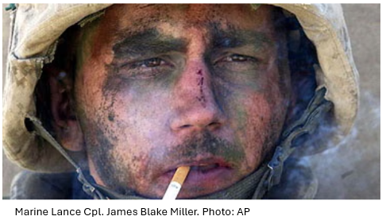
Problem Statement
Current VR therapies for PTSD overlook the sense of smell—crucial for memory and emotional processing.
Challenges include limited scent variety, inaccurate odor delivery, and lack of therapeutic models.
Current wearable technology is affected by lingering odors, odor intensity and heat buildup – minimizing the therapeutical treatment.
Focus on PTSD-related odors: smoke, gunpowder, diesel, and burnt rubber.
Notes:
Project integrates a machine learning-based scent classification model and a wearable scent emitter.
Targets trauma-related odors (smoke, gunpowder, diesel, burnt rubber) for VR exposure therapy.
Enables precise, controlled delivery of clinically relevant scents in immersive VR settings.
Addresses major limitations in current VR therapy by restoring a missing sensory modality.

Slide 4
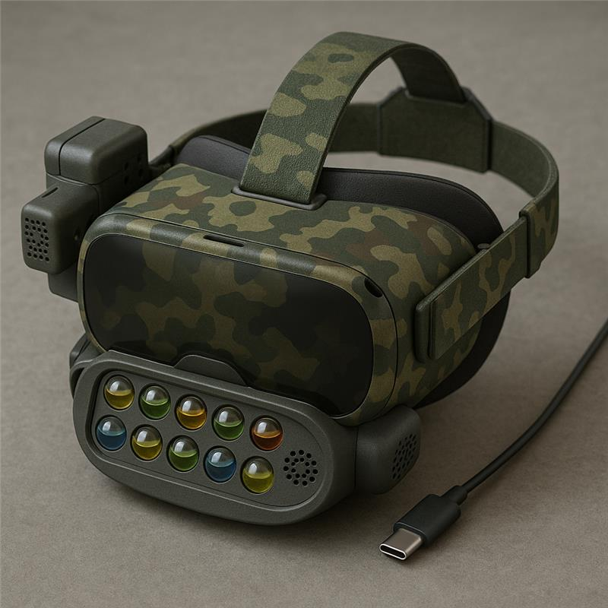
Literature Review
Olfactory Virtual Reality (OVR) is an emerging frontier enhancing VR immersion by incorporating smell.
Strong potential for treating PTSD, easing anxiety, and expanding multisensory therapy.
Smell strongly influences emotion, memory, and cognition
Current prototypes use airflow and scent emitters, but face key limitations such as Lingering odors, inconsistent intensity, heat dissipation and limited scent libraries
Cheminformatics and AI enable:
Odor profile prediction from mass spectra.
Scent generation based on semantic descriptors.
First studies to create real scents aligned with odor descriptors validated via human evaluation.
Use of autoencoders and SMOTE to predict perception from essential oil spectra.
Generation of new physical scents with targeted descriptors
Notes:
Our literature review focused on research studies providing insight into olfactory concepts with three unique viewpoints and the latest in smell delivery of VR applications.
Olfactory Virtual Reality or OVR is an emerging frontier enhancing VR immersion by incorporating smell, a critical yet historically overlooked sense.
There is strong potential for treating PTSD, easing anxiety, and expanding multisensory therapy.
Smell strongly influences emotion, memory, and cognition, offering untapped potential in therapy, education, training, and user presence.
There are challenges with current technology:
Prototypes use airflow and scent emitters, but face key limitations:
Lingering odors
Inconsistent intensity
Heat dissipation
Limited scent libraries (often biased toward pleasant floral notes)
Breakthroughs in Digital Olfaction include Cheminformatics + AI now enable:
Algorithmic scent design
Odor profile prediction that can be accomplished from mass spectra data
Using autoencoders and the synthetic minority oversampling technique or SMOTE to improve model performance.
To allow the generation of new physical scents with targeted descriptors
Validated by sensory evaluation, these advances mark the transition from odor reproduction to digital scent synthesis.
Our literature review examines three emerging perspectives on olfactory integration in VR, focusing on recent innovations in scent delivery.
Olfactory Virtual Reality (OVR) enhances immersion by engaging smell—a powerful, often overlooked sense closely tied to memory, emotion, and cognition. OVR shows strong promise for treating PTSD, reducing anxiety, and advancing multisensory therapy, education, and training.
Current prototypes rely on airflow and scent emitters but face key limitations: • Lingering odors • Inconsistent intensity • Heat buildup • Narrow scent libraries focused on pleasant, floral notes
Breakthroughs in digital olfaction—powered by chem informatics and AI—now enable: • Algorithmic scent design • Odor profile prediction from mass spectra • Model improvement via autoencoders and SMOTE • and provides generation of new physical scents with targeted descriptors
Sensory validation confirms these advances are shifting the field from odor reproduction toward true digital scent synthesis.

Slide 5
Literature Review
Neuroscience & Linguistic Integration
Smell linked directly to the limbic system → influences fear, emotion, and memory.
Word embeddings (e.g., Word2Vec) bridge language and olfactory perception.
Cross-cultural descriptors highlight limitations in English odor vocabulary.
Research Gaps
Need for calibration of odor intensity based on individual olfactory thresholds.
Few clinical trials validating OVR for trauma-specific therapy.
Little to no data on odor parameters needed for OVR therapy for PTSD cases.
VR technology - more development needed in thermal management, odor dissipation, and sensorial consistency.
Outlook – Advances in Neuroscience, Chemistry, and AI paving the way for OVR
Notes:
Next, we reviewed literature regarding Neuroscience & Linguistic Integration
Some key finding were
Smell linked directly to the limbic system → influences fear, emotion, and memory.
Word embeddings (e.g., Word2Vec) bridge language and olfactory perception.
Cross-cultural descriptors highlight limitations
Gaps we discovered were there is little to no data on odor parameters needed for OVR therapy targeting specific PTSD cases
Device constraints: size, scent delivery speed, and scent resolution.
User variability: Differences in olfactory thresholds complicate standardization.
Immersion barriers: Heat buildup and scent overlap disrupt realism.
Calibration gaps – a need for clinical trials to optimize therapeutic OVR devices for personalized, perceptually accurate experiences.
Limited scent libraries (often biased toward pleasant floral notes)
Outlook:
Interdisciplinary advances in neuroscience, chemistry, and AI, such as LLMs are paving the way for OVR to become a core component of future virtual environments, offering emotional depth, realism, and clinical impact.
We reviewed literature on the intersection of neuroscience and linguistic integration in OVR.
Key findings include:
Smell is directly linked to the limbic system, influencing fear, emotion, and memory.
Word embeddings (e.g., Word2Vec) help connect language with olfactory perception.
Cross-cultural odor descriptors reveal linguistic limitations in scent labeling.
Identified gaps in literatures include:
Minimal data on odor parameters tailored for PTSD-related OVR therapy
Device constraints: such as - size, scent delivery speed, and resolution
Existing Immersion challenges
And Scent libraries skewed toward pleasant/floral notes
The Outlook of Interdisciplinary innovation—combining neuroscience, chemistry, and AI (including large language models)—is positioning OVR as a transformative tool for emotional realism and clinical applications in future virtual environments.

Slide 6
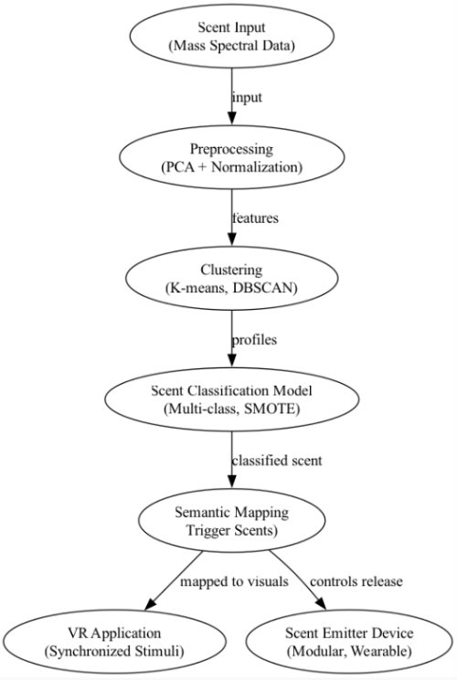
Methodology – Technical Overview
Integrated Modeling Framework
Combine scent classification and hardware design using dual-pillar methodology
Build meaningful semantic-linguistic clustering model to group 39 + 13 descriptors to 12 clinically meaningful scent profiles
Use Neural Network models with and without PCA to classify EO MS to target clusters
Design a modular, SysML driven scent emitter device with embedded ports, thermal controls, and feedback systems linked to stakeholder requirements
Ensure traceability via requirement-to-design mapping in SysML blocks and validate clinical relevance and performance through improvements on previous research
Notes:
Let’s walk through the core methodology behind our capstone project, which is built around an integrated modeling framework.
We’re using a dual-pillar methodology that will merge two key components: a scent classification pipeline and a hardware design for a wearable scent emitter.
First, we will focus on building a semantic-linguistic clustering model. Starting with 39 base descriptors and adding 13 additional clinically relevant terms, then grouped these into 12 meaningful scent clusters. These clusters serve as the target outputs for the classification model. To classify essential oil mass spectra into these clusters, we will train two neural network models, CNN and MLP, both with and without PCA for dimensionality reduction. This will allow the team to assess performance impacts and maintain model flexibility.
The second pillar is hardware design. We will create a SysML-driven modular scent emitter. This device will include thermal controls, embedded flow ports, and feedback mechanisms, all of which will be mapped back to stakeholder and clinical requirements using SysML for traceability. Importantly, we will validate the system through iterative refinement. This will mean mapping requirements directly into SysML blocks and ensuring that the design decisions are traceable and performance-driven, building on and improving prior research.
On the right, you can see a simplified flow diagram of the expected process, from inputting scent data, preprocessing and clustering, through to semantic mapping and final application in a VR environment with a synchronized scent release.

Slide 7
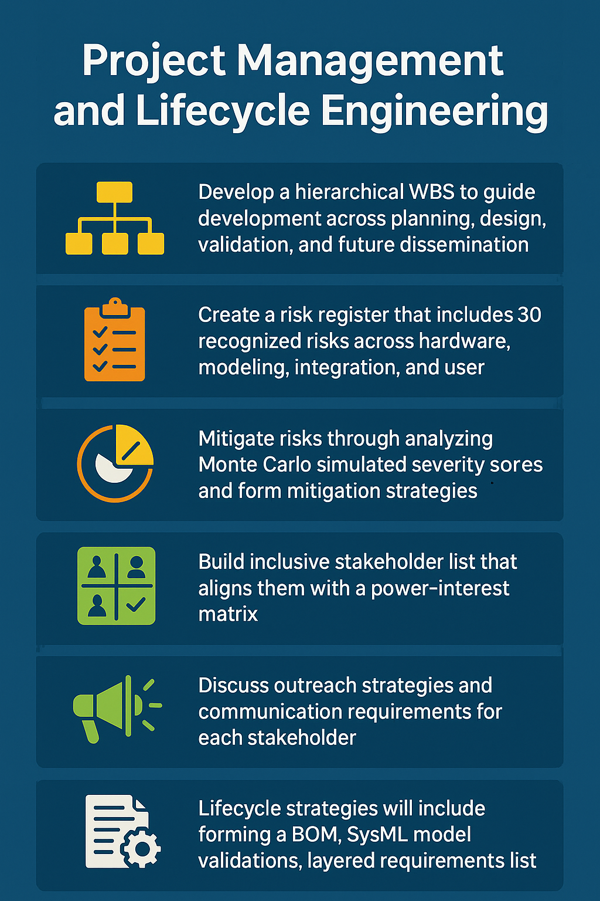
Methodology – Project & Lifecycle Strategy
Project Management and Lifecycle Engineering
Establish a structured development flow
Apply simulation-based methods to evaluate and prioritize risk response
Categorize stakeholders by influence and interest for tailored engagement
Prepare long-term system assets such as
Documentation
Validation models
Transfer plans
Notes:
Alongside the two core components of the project, our team will outline the project management and lifecycle strategies, which are crucial to maintaining structure, traceability, and stakeholder alignment across the project timeline.
We will establish a structured development flow, centered on systems engineering principles.
This includes a hierarchical Work Breakdown Structure, which will guide efforts across planning, design, validation, and eventual dissemination of the system.
To proactively manage uncertainty, we will develop a risk register capturing over 30 risks spanning hardware, modeling, integration, and user experience.
We will apply Monte Carlo simulation techniques to assess risk severity and prioritize mitigation strategies based on probabilistic outcomes.
Stakeholder engagement is another major focus. We will build a power-interest matrix to categorize stakeholders and tailor communication plans accordingly.
This will help ensure that both high-influence decision-makers and end users are properly considered in the design and validation process.
Finally, we will emphasize lifecycle sustainability. This will include creating long-term system assets, like documentation, validation models, and transfer plans. This is so that the system can evolve beyond our capstone.
We will also deliver a full set of lifecycle strategies, including a bill of materials, SysML model validations, and layered traceable requirements to ensure the system remains adaptable and clinically relevant.

Slide 8
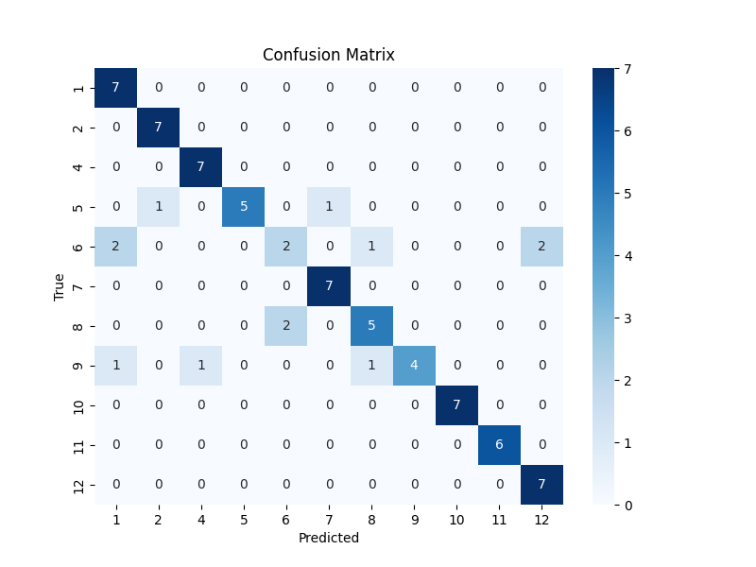
Analysis– Modeling Performance and Insights
Predictive Scent Modeling Results
From the 4 models, the CNN with PCA showed the highest cluster classification accuracy
Improving on the previous research models from around 70% to the current model's mid 80%
This model considers precision with a high F-1 score of mid 80% as well
Semantic clustering improved generalization across rare descriptors and trauma-linked scents
Cluster mapping revealed strong differentiation between target profiles and the remaining profiles
Model | Accuracy | F1 Score | Mean Confidence
CNN with PCA | 0.8421 | 0.8421 | 0.9097
CNN without PCA | 0.7957 | 0.7957 | 0.9267
MLP with PCA | 0.7632 | 0.7632 | 0.8218
MLP without PCA | 0.7527 | 0.7527 | 0.9099
Notes:
After completing our methodology and initial data preparation, we moved into the core analysis phase, beginning with performance evaluation of our predictive scent models.
Among the four models tested, the CNN with PCA achieved the highest cluster classification accuracy and F1 score, both in the mid-80% range, significantly outperforming previous benchmarks around 70%. This model also showed strong generalization across rare descriptors and trauma-linked scents due to the use of semantic clustering. Our cluster mapping highlighted strong separation of target scent profiles like Smoke, Burning Rubber, and Diesel, but also revealed a gap in training for the Gunpowder cluster due to insufficient data. Because SMOTE requires at least two instances to oversample, this cluster was excluded from model training. To resolve this, we plan to expand the dataset with additional oils that match niche descriptors.
The performance table on the left compares each model’s accuracy, F1 score, and confidence, while the confusion matrix on the right illustrates clear diagonal dominance, signifying strong classification, with minor overlaps, particularly between Clusters 1, 6, and 12. These overlaps may stem from shared semantic descriptors like Warm or Pleasant, or similar underlying chemical profiles.
Overall, the model advances the field by improving nuanced scent classification and laying the foundation for future scent-based VR therapies.

Slide 9
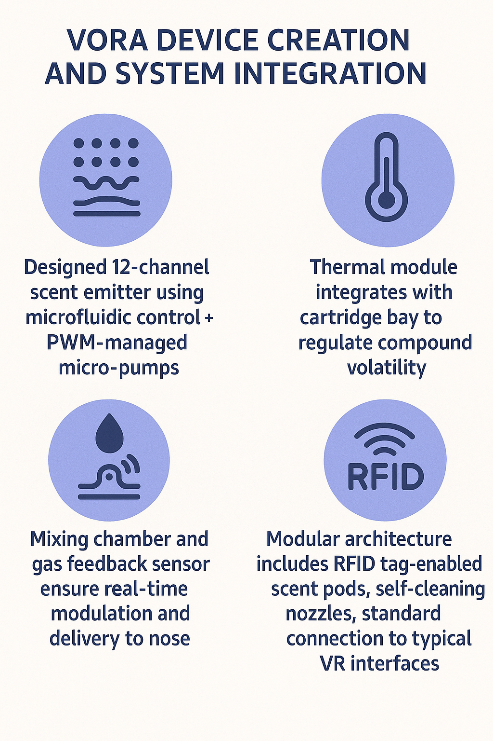
Analysis– Device Design and Integration
VORA Device Design and Requirement Mapping
System links stakeholder requirements to SysML modeling by including
Disposable scent channels near nose and system cleaning through UV-C LEDs ensuring optimal sterilization on internal and external parts, flexible for use between patients
Modular cartridges and open VR Interface ensure wide range of user applications without requiring special instructions or tweaks
Real-time feedback of scent emission/linger as well as thermal regulation ensure users receive high-quality olfactory feedback whenever they get the visual stimuli
Notes:
Next, we’ll look at the VORA device design and how stakeholder requirements are integrated through SysML modeling.
The system incorporates disposable scent channels and UV-C LED sterilization to ensure safe, hygienic use between patients. Its modular cartridge system and open VR interface support a wide range of applications, without requiring special configurations. We embed real-time feedback via gas sensors and thermal regulation modules to synchronize scent emission with visual stimuli, enhancing immersion and control.
As shown on the right, key features include: A 12-channel microfluidic emitter with PWM-controlled micro-pumps, A thermal module for regulating compound volatility, RFID-tagged scent pods for tracking and control, and A mixing chamber with gas feedback sensors at the nose interface.
This integrated, clinically driven design improves on prior research by enabling overlapping scent delivery, refined thermal modulation, and reliable performance, making it both user-focused and technically robust.

Slide 10
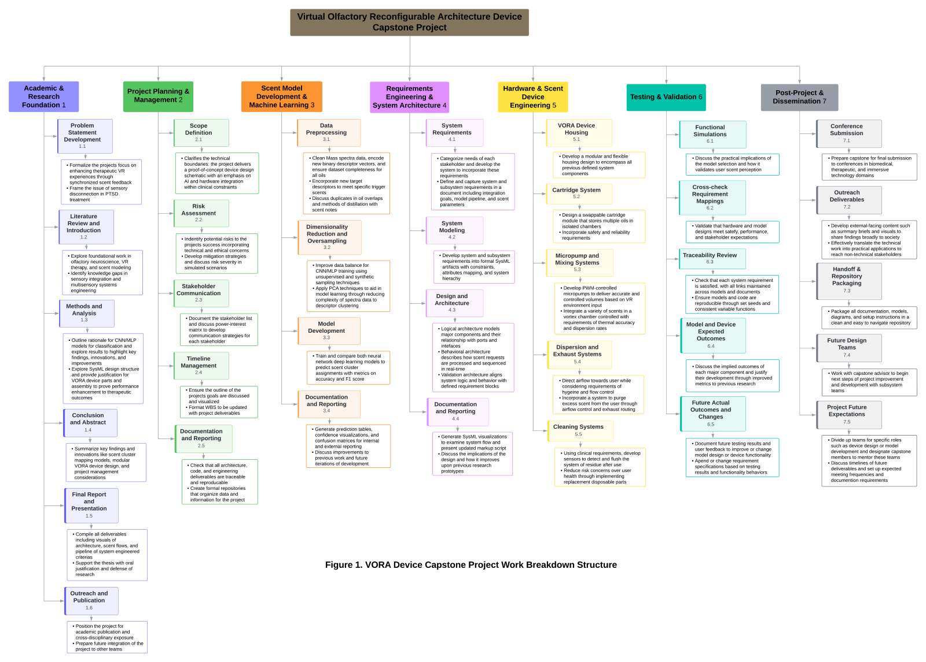
Analysis– Project Mangement Outcomes
Project Planning, Risk, and Stakeholder Strategy
Developed a 3-tier WBS with 7 initial domains and 34 sub-tasks
Documented structure ensure all tasks are complete with deliverables
Risk matrix evaluated 30 potential threats
Top risks were controlled through hardware and model safeguards
Simulated project severity of risks confirmed low probability of high-severity outcomes
Stakeholder matrix aligned clinical, technical, and user needs across system development
Notes:
The final part of our analysis focuses on project management outcomes, specifically our planning structure, risk mitigation, and stakeholder alignment.
We developed a 3-tier Work Breakdown Structure with 7 domains and 34 sub-tasks, ensuring every component was clearly defined and deliverable-driven.
The WBS, shown on the right, spans core areas from research and modeling to system architecture and dissemination.
To address uncertainty, we built a risk matrix evaluating 30 threats across hardware, modeling, and user interaction. Through simulation-based severity analysis and built-in safeguards, we confirmed a low likelihood of high-impact risks.
Our stakeholder matrix aligned clinical, technical, and user needs, guiding engagement strategies throughout the lifecycle.
The overall analysis of the project not only validated the technical feasibility of integrating scent into therapeutic VR systems but also contributed meaningful advancements to multisensory design, systems engineering, and olfactory research. Our work bridges critical gaps between clinical needs, immersive technology, and user-centered design, laying the groundwork for future applications in both healthcare and human experience research.

Slide 11
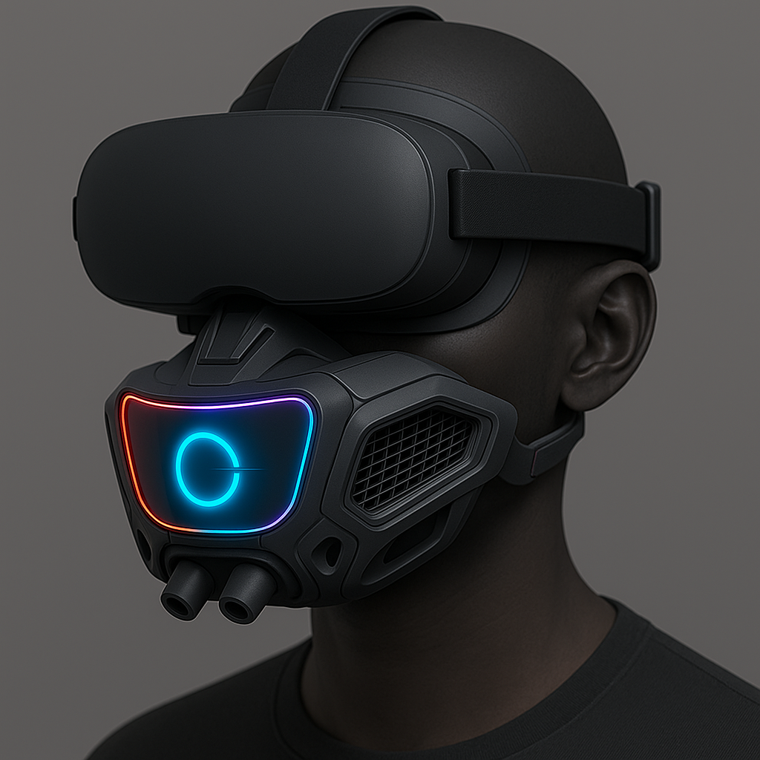
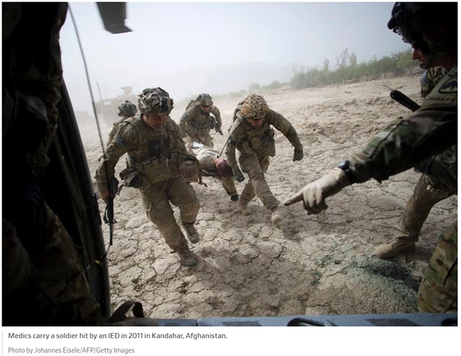
Systems Approach and Multidisciplinary Impact
Systems engineering practices guide design: requirements tracking, risk assessment, stakeholder engagement.
Key stakeholders: PTSD patients, healthcare providers, tech developers, regulators.
Multidisciplinary methods combine machine learning, chemical engineering, and systems design.
Goal: improve PTSD treatment by delivering immersive, scent-enriched virtual environments.
Notes:
“To create a functional, reliable, and clinically effective olfactory VR therapy system, we applied a systems engineering approach. This methodology allows us to manage complexity by clearly defining requirements, assessing risks early, and engaging stakeholders throughout the development lifecycle.”
“We used standard systems engineering practices such as:
Requirements tracking
Risk assessment
And stakeholder engagement
“We identified four primary stakeholder groups:
PTSD patients
Healthcare providers
Tech developers
And regulatory bodies.”
“This project also brings together multiple disciplines such as:
Machine learning.
Chemical engineering
And systems design

Slide 12
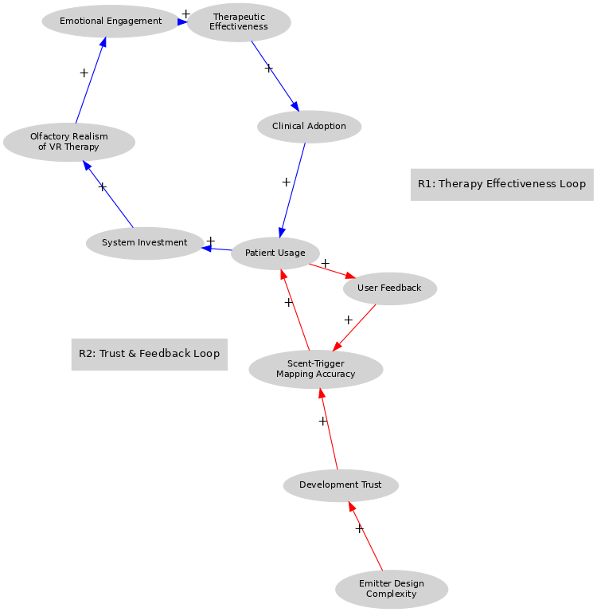
Systems Thinking View
Casual Loop Diagram
Represents how system components interact over time through feedback loops to influence outcomes like therapy effectiveness and clinical adoption.
R1 Loop (blue arrows) illustrates how improving therapy leads to broader adoption, which then fuels more development and innovation.
R2 Loop (red arrows) shows how feedback and trust contribute to system refinement:
This diagram visually captures the dynamic complexity of integrating olfactory cues into VR therapy. It shows that:
Technology (emitters, realism), user experience (engagement and feedback), and clinical outcomes (adoption, effectiveness) are all interconnected.
The system relies on continuous input from users and trust from developers and clinicians to evolve.
Investment and usage form the bridge between technical development and clinical success.
Notes:
“This slide introduces a causal loop diagram, a powerful tool used in systems thinking to visualize how different parts of a system interact over time. It helps us understand the feedback mechanisms that either reinforce or balance change within the system.”
“This diagram shows how olfactory VR therapy for PTSD evolves over time—how it gets better, more accepted, and more widely used as certain elements of the system improve.”
“The R1 loop, shown in blue arrows is a positive feedback cycle:
As therapeutic effectiveness improves, we see greater clinical adoption.
That adoption leads to more patient usage and investment in system development.
More investment drives improvements in the VR therapy—particularly in scent realism—which then circles back to increase effectiveness.
“The R2 loop, in red arrows, focuses on the user and developer trust cycle:
More patient usage and user feedback improve the accuracy of scent-trigger mapping.
Combined with development trust, this enables refinements to both software and hardware.
These improvements enhance the user experience, encouraging further use.
“Taken together, this diagram tells us that the system is not linear—it’s highly dynamic and interconnected:
The technology (like scent emitters and realism),
The user experience (engagement, feedback, and trust),
And the clinical outcomes (effectiveness and adoption)
…all influence one another in a continuous, evolving process.”
“This systems view emphasizes that in order to create meaningful change, we need to address not just the device or the algorithm, but the entire ecosystem—from user trust to clinical validation to iterative design.”
R1 loop: Emotional Engagement → improves →
Therapeutic Effectiveness → drives →
Clinical Adoption → increases →
Patient Usage → justifies →
System Investment → enhances →
Olfactory Realism of VR Therapy → boosts →
Emotional Engagement (loop closes)
R2 Loop: Patient Usage → leads to →
User Feedback → improves →
Scent-Trigger Mapping Accuracy → builds →
Development Trust → encourages →
Emitter Design Complexity → supports →
Scent-Trigger Mapping Accuracy (via trust & hardware) → and loops back via →
Patient Usage
Systems engineering practices guide design: requirements tracking, risk assessment, stakeholder engagement.
Key stakeholders: PTSD patients, healthcare providers, tech developers, regulators.
Multidisciplinary methods combine machine learning, chemical engineering, and systems design.
Goal: improve PTSD treatment by delivering immersive, scent-enriched virtual environments.

Slide 13
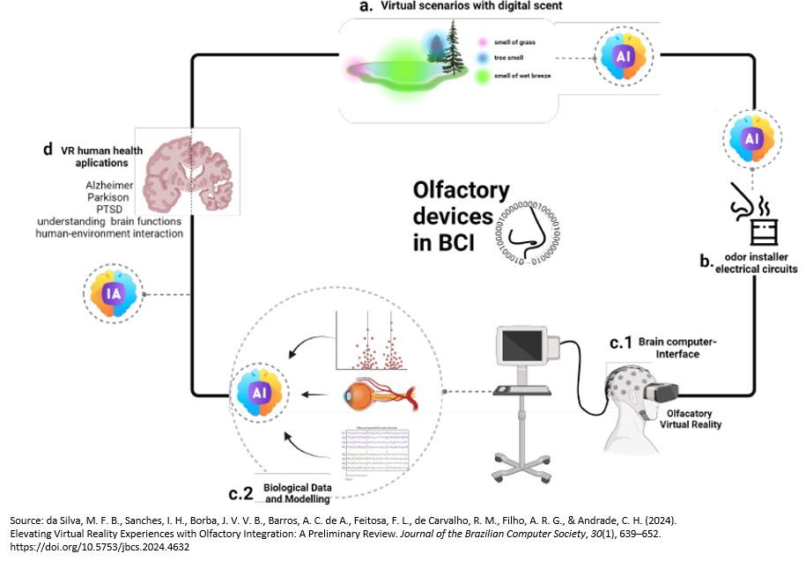
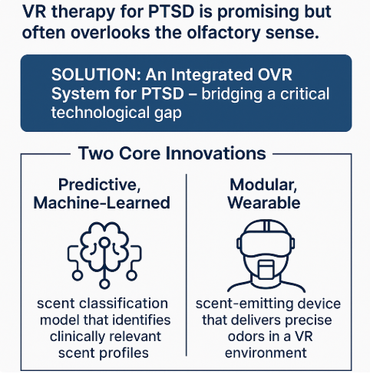
Conclusion
Notes:
Our team focused on VR therapy for PTSD patients, namely those who serve in the military, first responders and in healthcare.
We were able to bridge a technological gap by:
Developing a Predictive, scent classification model that identifies clinically relevant scent profiles.
Through systems engineering, design a wearable device to deliver precise odors in a VR environment.
The visual on the right shows the workflow for the description of devices using OVR in medical studies for PTSD.
Engineered for Reliability
Rigorous systems engineering with traceability, stakeholder engagement and risk management.
Enhanced Scent Delivery
Micropump technology replaces atomization for improved precision, thermal safety and scalability.
Clinical-Grade Features
Our systems design includes RFID oil pod tracking, UV Sterilization and disposable nozzles ensure hygiene and safety
Modular and Scalable Design
Built for therapeutic use with a focus on robustness and adaptability.
Our team focused on advancing VR therapy for PTSD, specifically targeting military personnel, first responders, and healthcare professionals.
We bridged a critical technological gap by:
Developing a predictive scent classification model to identify clinically relevant odor profiles
Designing a wearable scent delivery device through systems engineering for precise odor release in VR environments
The image to the right illustrates the clinical workflow of OVR devices used in PTSD-related medical studies.
Key Engineering Contributions
Engineered for Reliability
Applied systems engineering with traceability, stakeholder input, and risk mitigation
Enhanced Scent Delivery
Replaced atomization with micropump technology for precise, safe, and scalable odor release
Clinical-Grade Features
Integrated RFID oil pod tracking, UV sterilization, and disposable nozzles for hygiene and safety
Modular & Scalable Design
Designed for clinical environments with modular components for easy integration and future expansion

Slide 14
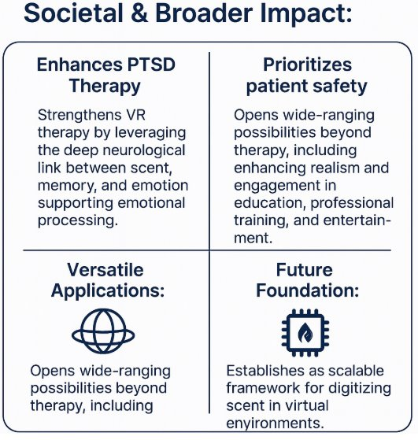
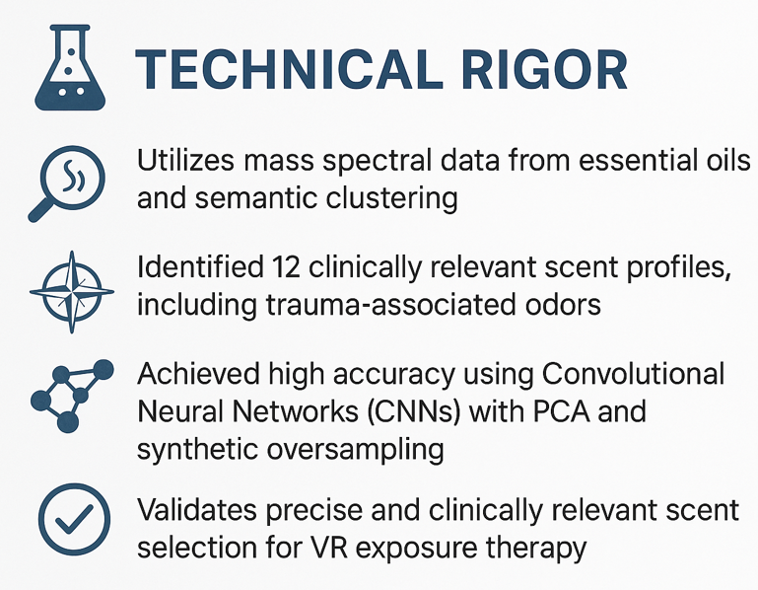
Conclusion
Notes:
Our team stressed technical rigor by first tracking down proven, verified data. This was not a simple task because the smells we were after aren’t the type you find in many essential oils, perfumes or colognes.
From gathering mass spectral data to identifying 12 scent profiles, including those for PTSD – our goal was to verify models with true data.
Next, we were able to achieve high accuracy using CNNs with PCA and synthetic oversampling. This combined work validates the clinically relevant scent selection to use for therapy.
The most important customers of this work are those affected by PTSD related to military, first responders and healthcare. Anything that can be done to help these heroes should be a priority.
We developed an integrated OVR system to enhance PTSD VR therapy and designed a plan that prioritized patient safety.
The solution integrates with VR experiences and has a broad range of applications.
Last, we recommend future studies focus on digitizing more scents for the virtual environment. Trauma is real and providing true experiences with smell allow therapists to help more affected.
Candice, Dawson and I want to thank Dr. Sedighi and Dr. Wiggins for their guidance throughout this project. Answering our late-night questions and offering their support through the process.
Our team emphasized technical rigor by sourcing verified, real-world data.
We began by collecting and analyzing mass spectral data, ultimately identifying 12 clinically relevant scent profiles—including key trauma-associated odors. Our goal was to ensure the model was grounded in real, verifiable data.
To achieve high classification accuracy, we employed (CNNs) enhanced with principal component analysis (PCA) and synthetic oversampling techniques. This validated both our model and the therapeutic relevance of the selected scents.
The most important stakeholders in this work are those affected by PTSD—
We developed an integrated OVR system that enhances VR-based PTSD therapy and prioritizes patient safety. The system supports seamless VR integration and offers broad applications in therapy and training.
Looking ahead, we recommend future research expand digital scent libraries to reflect real-world trauma experiences. The more immersive the virtual environment, the more effective therapy can become.
Finally, Candice, Dawson, and I sincerely thank Dr. Sedighi and Dr. Wiggins for their guidance and late-night support throughout this project.

